Slide 1
Database
Q&A

Slide 2
WHAT IS CURSOR?
A cursor is a database object which is used to retrieve data from result set one row at a time. The cursor can be used when the data needs to be updated row by row.
A cursor is a pointer to a row.
Cursor is a temporary memory or temporary workstation. It is allocated by database server at time of performing DML operations on Table by user.

Slide 3
Types of Cursors in SQL
Types of Cursors in SQL:
Implicit Cursor
Explicit Cursor
Implicit Cursor: Whenever DML operations such as INSERT, UPDATE, and DELETE are processed in the database, implicit cursors are generated automatically and used by the framework. These types of cursors are used for internal processing and can’t be controlled or referred from another code area.
Explicit Cursor: This type of cursor is generated whenever data is processed by a user through an SQL block. Generally, the use of the SELECT query triggers the creation of an explicit cursor and can hold more than one row but process just one at a time.

Slide 4
CURSOR LIFE CYCLE
Declaring Cursor A cursor is declared by defining the SQL statement.
Opening Cursor A cursor is opened for storing data retrieved from the result set.
Fetching Cursor When a cursor is opened, rows can be fetched from the cursor one by one or in a block to do data manipulation.
Closing Cursor The cursor should be closed explicitly after data manipulation.
Deallocating Cursor Cursors should be deallocated to delete cursor definition and released all the system resources associated with the cursor.

Slide 5
WHY USE CURSORS?
In relational databases, operations are made on a set of rows. For example, a SELECT statement returns a set of rows which is called a result set. Sometimes the application logic needs to work with a row at a time rather than the entire result set at once. This can be done using cursors.

Slide 6
CURSOR LIMITATIONSA
cursor is a memory resident set of pointers -- meaning it occupies memory from your system that may be available for other processes
But, when you open a cursor, you are basically loading those rows into memory and locking them, creating potential blocks. Then, as you cycle through the cursor, you are making changes to other tables and still keeping all of the memory and locks of the cursor open.
When processing data, it imposes locks on a subset or the entire table.
The cursor updates table records one row at a time, which slows down its performance.
While loops are slower than cursors, they do have more overhead.

Slide 7
Cursor Alternate
Temporary tables & While Loop

Slide 8
How to find nth highest salary in sql
with Emp as
(
select *,DENSE_RANK() over (order by salary desc) as RankID from Employee
)
select top 1 * from Emp where RankID=N

Slide 9
How to find 1th highest salary in sql
select max(Salary) from Employee

Slide 10
How to find 2th highest salary in sql
with Emp as
(
select *,DENSE_RANK() over (order by salary desc) as RankID from Employee
)
select top 1 * from Emp where RankID=2

Slide 11
How to find 15th highest salary in sql
with Emp as
(
select *,DENSE_RANK() over (order by salary desc) as RankID from Employee
)
select top 1 * from Emp where RankID=15

Slide 12
SQL query to get organization hierarchy
with Emp as
(
select EmployeeID,Name,Salary,ManagerID from Employee where EmployeeID=1
union all
select Employee.EmployeeID,Employee.Name,Employee.Salary,Employee.ManagerID from Employee join Emp onEmployee.EmployeeID=Emp.ManagerID
)
select EmployeeID,Name,Salary,ManagerID from Emp

Slide 13
Delete duplicate rows in sql
WITH EmployeesCTE AS
(
SELECT *, ROW_NUMBER()OVER(PARTITION BY Name ORDER BY EmployeeID) AS RowNumber FROM Employee
)
Delete from EmployeesCTE where RowNumber>1

Slide 14
SQL query to find employees hired in last n months
select *,DATEDIFF(MONTH,HireDate,GETDATE()) as datediffnum from Employee where DATEDIFF(MONTH,HireDate,GETDATE()) between 1 and 12

Slide 15
Transform rows into columns in sql server
select country , city1,city2,city3 from
(
select *,'City'+ cast(ROW_NUMBER() over(partition by Country order by City) as nvarchar(10)) as CityID from Countries
) tmp
pivot
(
MAX(City) for CityID in(city1,city2,city3)
) as pivottable

Slide 16
SQL query to find rows that contain only numerical data
SELECT Value FROM TestTable WHERE ISNUMERIC(Value) = 1

Slide 17
SQL Query to find department with highest number of employees
select Department.Name, count(Employee.EmployeeID) from Department inner join Employee on Department.DepartmentPID=Employee.DepartmentPID group by Employee.DepartmentPID,Department.Name

Slide 18
Can we join two tables without primary foreign key relation?
Yes, we can join two tables without primary foreign key relation as long as the column values involved in the join can be converted to one type.

Slide 19
Difference between blocking and deadlocking
Blocking : Occurs if a transaction tries to acquire an incompatible lock on a resource that another transaction has already locked. The blocked transaction remains blocked until the blocking transaction releases the lock.
Deadlock : Occurs when two or more transactions have a resource locked, and each transaction requests a lock on the resource that another transaction has already locked. Neither of the transactions here can move forward, as each one is waiting for the other to release the lock. So in this case, SQL Server intervenes and ends the deadlock by cancelling one of the transactions, so the other transaction can move forward.

Slide 20
Sql query to select all names that start with a given letter without like operator
SELECT * FROM Employee WHERE Name LIKE 'M%'
SELECT * FROM Students WHERE CHARINDEX('M',Name) = 1
SELECT * FROM Students WHERE LEFT(Name, 1) = 'M'
SELECT * FROM Students WHERE SUBSTRING(Name, 1, 1) = 'M'

Slide 21
Sql date interview questions
1. All people who are born on a given date (For example, 9th October 2017)
SELECT Name, DateOfBirth, CAST(DateOfBirth AS DATE) AS [DatePart] FROM Employees WHERE CAST(DateOfBirth AS DATE) = '2017-10-09'
2. All people who are born between 2 given dates (For example, all people born between Nov 1, 2017 and Dec 31, 2017)
SELECT Name, DateOfBirth, CAST(DateOfBirth AS DATE) AS [DatePart] FROM Employees WHERE CAST(DateOfBirth AS DATE) BETWEEN '2017-11-01' AND '2017-12-31'
3. All people who are born on the same day and month excluding the year (For example, 9th October)
SELECT Name, DateOfBirth, CAST(DateOfBirth AS DATE) AS [DatePart] FROM Employees WHERE DAY(DateOfBirth) = 9 AND Month(DateOfBirth) = 10
5. All people whose birth year is the same (For example, all people born in 2017, 2018 etc.)
SELECT Name, DateOfBirth, CAST(DateOfBirth AS DATE) AS [DatePart] FROM Employees WHERE YEAR(DateOfBirth) = 2017

Slide 22
Sql date interview questions
4. All people who are born yesterday, today, tomorrow, last seven days, and next 7 days
--yesterday
SELECT Name, DateOfBirth, CAST(DateOfBirth AS DATE) AS [DatePart] FROM Employees WHERE CAST(DateOfBirth AS DATE) = DATEADD(DAY, -1, CAST(GETDATE() AS DATE))
--tomorrow
SELECT Name, DateOfBirth, CAST(DateOfBirth AS DATE) AS [DatePart] FROM Employees WHERE CAST(DateOfBirth AS DATE) = DATEADD(DAY, 1, CAST(GETDATE() AS DATE))
--yesterday and today\since yesterday
SELECT Name, DateOfBirth, CAST(DateOfBirth AS DATE) AS [DatePart] FROM Employees WHERE CAST(DateOfBirth AS DATE) BETWEEN DATEADD(DAY, -1, CAST(GETDATE() AS DATE))
AND CAST(GETDATE() AS DATE)
--last 7 days (excluding today)
SELECT Name, DateOfBirth, CAST(DateOfBirth AS DATE) AS [DatePart] FROM Employees
WHERE CAST(DateOfBirth AS DATE) BETWEEN DATEADD(DAY, -7, CAST(GETDATE() AS DATE)) AND DATEADD(DAY, -1, CAST(GETDATE() AS DATE))
--today
SELECT Name, DateOfBirth, CAST(DateOfBirth AS DATE) AS [DatePart] FROM Employees WHERE CAST(DateOfBirth AS DATE) = CAST(GETDATE() AS DATE)

Slide 23
Sql query to delete from multiple tables\ delete cascade
Alter table Employees add constraint FK_Dept_Employees_Cascade_Delete foreign key (DeptId) references Departments(Id) on delete cascade

Slide 24
Sql function to get number from string
Create function UDF_ExtractNumbers
(
-- Input is alphanumeric string
@input varchar(255)
)
-- Returns numbers as a string
Returns varchar(255)
As
Begin
-- Returns the index of a character that is not a number
-- If the specified pattern is not found, ZERO is returned
Declare @alphabetIndex int = Patindex('%[^0-9]%', @input)
Begin
While @alphabetIndex > 0
Begin
-- In the input string (@input) at the position (@alphabetIndex)
-- where we have a non-numeric chracter, replace that 1
-- character with an empty string ('')
Set @input = Stuff(@input, @alphabetIndex, 1, '' )
-- Find the next non-numeric character and repeat the above step
-- until all non-numeric characters are replaced with an empty string
Set @alphabetIndex = Patindex('%[^0-9]%', @input )
End
End
Return @input
End
Select dbo.UDF_ExtractNumbers(IDName) as ID as Numbers from TestTable

Slide 25
Sql function to get text from string
Create function UDF_ExtractAlphabets
(
-- Input is alphanumeric string
@input varchar(255)
)
-- Returns numbers as a string
Returns varchar(255)
As
Begin
-- Returns the index of a character that is not an alphabet
-- If an alphabet is not found, ZERO is returned
Declare @numberIndex int = Patindex('%[^a-zA-Z]%', @input)
Begin
While @numberIndex > 0
Begin
-- In the input string (@input) at the position (@numberIndex)
-- where we have an alphabetic chracter, replace that 1 alphabetic
-- character with an empty string ('')
Set @input = Stuff(@input, @numberIndex, 1, '' )
-- Find the next alphabetic character and repeat the above step
-- until all alphabetic characters are replaced with an empty string
Set @numberIndex = Patindex('%[^a-zA-Z]%', @input )
End
End
Return @input
End
Select dbo.UDF_ExtractAlphabets(IDName) as Name from TestTable
Select dbo.UDF_ExtractNumbers(IDName) as ID, dbo.UDF_ExtractAlphabets(IDName) as Name from TestTable

Slide 26
Sql server select where in list
Declare @FirstNamesList nvarchar(100) = 'Mark,John,Sara'
SELECT * FROM Employees where FirstName IN (SELECT * FROM STRING_SPLIT(@FirstNamesList, ','))
Declare @FirstNamesList nvarchar(100) = 'Mark,John,Sara'
SELECT Employees.* FROM Employees
JOIN STRING_SPLIT(@FirstNamesList, ',') Result
ON Result.VALUE = Employees.FirstName

Slide 27
Sql select most repeated value
select Department.DepartmentPID,Department.Name,count(*) as EmployeeCount from [dbo].[Employee]
inner join Department on Employee.DepartmentPID=Department.DepartmentID
group by Department.DepartmentPID,Department.Name

Slide 28
Declare @emp nvarchar(256)
select @emp=Name from [dbo].[Employee]
print @emp
select * from [dbo].[Employee]

Slide 29
What is Trigger?
A trigger is a special type of stored procedure that automatically runs when an event occurs in the database server. DML triggers run when a user tries to modify data through a data manipulation language (DML) event. DML events are INSERT, UPDATE, or DELETE statements on a table or view. These triggers fire when any valid event fires, whether table rows are affected or not.

Slide 30
Types of triggers
DML Triggers
DDL Triggers

Slide 31
DDL
DDL triggers fire in response to a variety of Data Definition Language (DDL) events. These events primarily correspond to Transact-SQL statements that start with the keywords CREATE, ALTER, DROP, GRANT, DENY, REVOKE or UPDATE STATISTICS. Certain system stored procedures that perform DDL-like operations can also fire DDL triggers.
Use DDL triggers when you want to do the following:
Prevent certain changes to your database schema.
Have something occur in the database in response to a change in your database schema.
Record changes or events in the database schema.

Slide 32
Types of DDL Triggers
Transact-SQL DDL Trigger
CLR DDL Trigger

Slide 33
DDL Trigger Example
CREATE TRIGGER safety
ON DATABASE
FOR DROP_TABLE, ALTER_TABLE
AS
PRINT 'You must disable Trigger "safety" to drop or alter tables!'
ROLLBACK;

Slide 34
DML
DML triggers is a special type of stored procedure that automatically takes effect when a data manipulation language (DML) event takes place that affects the table or view defined in the trigger. DML events include INSERT, UPDATE, or DELETE statements. DML triggers can be used to enforce business rules and data integrity, query other tables, and include complex Transact-SQL statements. The trigger and the statement that fires it are treated as a single transaction, which can be rolled back from within the trigger. If a severe error is detected (for example, insufficient disk space), the entire transaction automatically rolls back.

Slide 35
Types of DML Triggers
AFTER trigger
INSTEAD OF trigger

Slide 36
AFTER trigger
AFTER trigger:-AFTER triggers are executed after the action of the INSERT, UPDATE, MERGE, or DELETE statement is performed. AFTER triggers are never executed if a constraint violation occurs; therefore, these triggers cannot be used for any processing that might prevent constraint violations. For every INSERT, UPDATE, or DELETE action specified in a MERGE statement, the corresponding trigger is fired for each DML operation.

Slide 37
AFTER trigger Example
CREATE TRIGGER Purchasing.LowCredit ON Purchasing.PurchaseOrderHeader
AFTER INSERT
AS
IF (ROWCOUNT_BIG() = 0)
RETURN;
IF EXISTS (SELECT 1
FROM inserted AS i
JOIN Purchasing.Vendor AS v
ON v.BusinessEntityID = i.VendorID
WHERE v.CreditRating = 5
)
BEGIN
RAISERROR ('A vendor''s credit rating is too low to accept new
purchase orders.', 16, 1);
ROLLBACK TRANSACTION;
RETURN
END;
GO

Slide 38
INSTEAD OF trigger
INSTEAD OF trigger:-INSTEAD OF triggers override the standard actions of the triggering statement. Therefore, they can be used to perform error or value checking on one or more columns and perform additional actions before inserting, updating or deleting the row or rows. For example, when the value being updated in an hourly wage column in a payroll table exceeds a specified value, a trigger can be defined to either produce an error message and roll back the transaction, or insert a new record into an audit trail before inserting the record into the payroll table. The primary advantage of INSTEAD OF triggers is that they enable views that would not be updatable to support updates.
For example, a view based on multiple base tables must use an INSTEAD OF trigger to support inserts, updates, and deletes that reference data in more than one table. Another advantage of INSTEAD OF triggers is that they enable you to code logic that can reject parts of a batch while letting other parts of a batch to succeed.

Slide 39
INSTEAD OF trigger Example
CREATE TRIGGER tr_vwEmployeeDetails_InsteadOfInsert
ON vwEmployeeDetails
INSTEAD OF INSERT
AS
BEGIN
DECLARE @DepartmenttId int
-- First Check if there is a valid DepartmentId in the Department Table
-- for the given Department Name
SELECT @DepartmenttId = dept.ID
FROM Department dept
INNER JOIN INSERTED inst
on inst.Department = dept.Name
--If the DepartmentId is null then throw an error
IF(@DepartmenttId is null)
BEGIN
RAISERROR('Invalid Department Name. Statement terminated', 16, 1)
RETURN
END
-- Finally insert the data into the Employee table
INSERT INTO Employee(ID, Name, Gender, Salary, DeptID)
SELECT ID, Name, Gender, Salary, @DepartmenttId
FROM INSERTED
End

Slide 40
What is SP(Stored Procedure)?
A stored procedure in SQL Server is a group of one or more Transact-SQL statements, or a reference to a Microsoft .NET Framework common runtime language (CLR) method. Procedures resemble constructs in other programming languages because they can:
Accept input parameters and return multiple values in the form of output parameters to the calling program.
Contain programming statements that perform operations in the database. These include calling other procedures.
Return a status value to a calling program to indicate success or failure (and the reason for failure).

Slide 41
Benefits of using stored procedures
Reduced server/client network traffic
Stronger security
Reuse of code
Easier maintenance
Improved performance
https://learn.microsoft.com/en-us/sql/relational-databases/stored-procedures/stored-procedures-database-engine?view=sql-server-ver16

Slide 42
Types of stored procedures
User-defined
Temporary
System
Extended user-defined
https://learn.microsoft.com/en-us/sql/relational-databases/stored-procedures/stored-procedures-database-engine?view=sql-server-ver16

Slide 43
Stored Procedure Syntax
CREATE PROCEDURE procedure_name AS sql_statement GO;

Slide 44
Stored Procedure Example
CREATE PROCEDURE SelectAllCustomers AS SELECT * FROM Customers GO;

Slide 45
What is function?
Functions in SQL Server are the database objects that contains a set of SQL statements to perform a specific task. A function accepts input parameters, perform actions, and then return the result. We should note that functions always return either a single value or a table. The main purpose of functions is to replicate the common task easily. We can build functions one time and can use them in multiple locations based on our needs.
SQL Server does not allow to use of the functions for inserting, deleting, or updating records in the database tables.

Slide 46
Types of function
System Function(Built-in functions)
User-defined Functions

Slide 47
System Functions(Built-in Functions)
String Functions (LEN, SUBSTRING, REPLACE, CONCAT, TRIM)
Date and Time Functions (datetime, datetime2, smalldatetime)
Aggregate Functions (COUNT, MAX, MIN, SUM, AVG)
Mathematical Functions (ABS, POWER, PI, EXP, LOG)
Ranking Functions (RANK, DENSE_RANK, ROW_NUMBER, NTILE)

Slide 48
User-defined functions
Functions that are created by the user in the system database or a user-defined database are known as user-defined functions.
user-defined functions types:
Scalar Functions
Table-Valued Functions

Slide 49
Benefits of user-defined functions
Modular programming. You can create the function once, store it in the database, and call it any number of times in your program. User-defined functions can be modified independently of the program source code.
Faster execution. Similar to stored procedures, Transact-SQL user-defined functions reduce the compilation cost of Transact-SQL code by caching the plans and reusing them for repeated executions. This means the user-defined function doesn't need to be reparsed and reoptimized with each use resulting in much faster execution times.
CLR functions offer significant performance advantage over Transact-SQL functions for computational tasks, string manipulation, and business logic. Transact-SQL functions are better suited for data-access intensive logic.
Reduce network traffic. An operation that filters data based on some complex constraint that can't be expressed in a single scalar expression can be expressed as a function. The function can then be invoked in the WHERE clause to reduce the number of rows sent to the client.

Slide 50
Scalar Functions
CREATE FUNCTION udfNet_Sales(
@quantity INT,
@price DEC(10,2),
@discount DEC(3,2)
)
RETURNS DEC(10,2)
AS
BEGIN
RETURN @quantity * @price * (1 - @discount);
END;

Slide 51
Table-Valued Functions
CREATE FUNCTION fudf_GetEmployee()
RETURNS TABLE
AS
RETURN (SELECT * FROM Employee)

Slide 52
Differences between Stored Procedure and User Defined Function in SQL Server
User Defined Function | Stored Procedure
Function must return a value. | Stored Procedure may or not return values.
Will allow only Select statements, it will not allow us to use DML statements. | Can have select statements as well as DML statements such as insert, update, delete and so on
It will allow only input parameters, doesn't support output parameters. | It can have both input and output parameters.
It will not allow us to use try-catch blocks. | For exception handling we can use try catch blocks.
Transactions are not allowed within functions. | Can use transactions within Stored Procedures.
We can use only table variables, it will not allow using temporary tables. | Can use both table variables as well as temporary table in it.
Stored Procedures can't be called from a function. | Stored Procedures can call functions.
Functions can be called from a select statement. | Procedures can't be called from Select/Where/Having and so on statements. Execute/Exec statement can be used to call/execute Stored Procedure.
A UDF can be used in join clause as a result set. | Procedures can't be used in Join clause

Slide 53
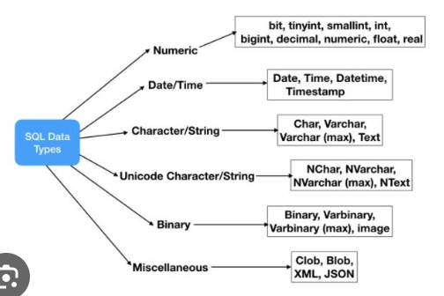
What is the Data Type of an image?
VARBINARY(MAX)

Slide 54
Table Type
The concepts of User-Defined Table Types (UDTTs) and Table-Valued Parameters (TVPs) were introduced in SQL Server 2008. Before SQL Server 2008, it was not possible to pass a table variable in a stored procedure as a parameter; after SQL Server, we can pass a Table-Valued Parameter to send multiple rows of data to a stored procedure or a function without creating a temporary table or passing so many parameters.
Before passing the table variable, first, we need to create a user-defined table variable. So now we create a user-defined table type.

Slide 55
Table Type Example
CREATE TYPE UT_Employee AS TABLE
(
Emp_Id int NOT NULL,
EmployeeName nvarchar(MAX),
EmpSalary varchar(50),
StateId varchar(50),
CityId varchar(50)
)

Slide 56
Table Type use Example
CREATE PROCEDURE USP_Insert_Employee_Infi
(
@Employee_Details [UT_Employee]
)
AS
BEGIN
INSERT INTO dbo.Employee
(
Emp_Id,
EmployeeName,
EmpSalary,
StateId,
CityId
)
SELECT * FROM @Employee_Details
END

Slide 57
View
A view is a virtual table whose contents are defined by a query. Like a table, a view consists of a set of named columns and rows of data. Unless indexed, a view does not exist as a stored set of data values in a database. The rows and columns of data come from tables referenced in the query defining the view and are produced dynamically when the view is referenced.

Slide 58
Types of views
Indexed views
Partitioned views
System views

Slide 59
View Example
CREATE VIEW HumanResources.EmployeeHireDate
AS
SELECT p.FirstName,
p.LastName,
e.HireDate
FROM HumanResources.Employee AS e
INNER JOIN Person.Person AS p
ON e.BusinessEntityID = p.BusinessEntityID;
GO
-- Query the view
SELECT FirstName,
LastName,
HireDate
FROM HumanResources.EmployeeHireDate
ORDER BY LastName;
GO

Slide 60
types of tables
Table Variable
Global Temporary Tables
Local Temporary Tables
User Tables (Regular Tables)

Slide 61
Table Variable
Table variable is a type of local variable that used to store data temporarily, similar to the temp table in SQL Server. Tempdb database is used to store table variables.
DECLARE @MyTableVar TABLE (
EmpID INT NOT NULL,
OldVacationHours INT,
NewVacationHours INT,
ModifiedDate DATETIME
);
UPDATE TOP (10) HumanResources.Employee SET VacationHours = VacationHours * 1.25
OUTPUT INSERTED.BusinessEntityID,DELETED.VacationHours,INSERTED.VacationHours,INSERTED.ModifiedDate
INTO @MyTableVar;
--Display the result set of the table variable.
SELECT EmpID,OldVacationHours,NewVacationHours,ModifiedDate FROM @MyTableVar;

Slide 62
what is the use of Primary key?
if primary foreign key relation is not mandatory for 2 tables to be joined then what is the use of these keys? Primary key enforces uniqueness of values over one or more columns. Since ID is not a primary key in Departments table, 2 or more departments may end up having same ID value, which makes it impossible to distinguish between them based on the ID column value. Foreign key enforces referential integrity. Without foreign key constraint on DepartmentId column in Employees table, it is possible to insert a row into Employees table with a value for DepartmentId column that does not exist in Departments table.

Slide 63
Why is it a bad idea to have a table without a primary key?
Here're some reasons why you should use primary keys (PKs):
They allow you to have a way to uniquely identify a given row in a table to ensure that there're no duplicates.
The RDBMS enforces this constraint for you, so you don't have to write additional code to check for duplicates before inserting, avoiding a full table scan, which implies better performance here.
PKs allow you to create foreign keys (FKs) to create relations between tables in a way that the RDBMS is "aware" of them. Without PKs/FKs, the relationship only exists inside the programmer's mind, and the referenced table might have a row with its "PK" deleted, and the other table with the "FK" still thinks the "PK" exists. This is bad, which leads to the next point.
It allows the RDBMS to enforce integrity constraints. Is TableA.id referenced by TableB.table_a_id? If TableB.table_a_id = 5 then, you're guaranteed to have a row with id = 5 in TableA. Data integrity and consistency is maintained, and that is good.
It allows the RDBMS to perform faster searches b/c PK fields are indexed, which means that a table doesn't need to have all of its rows checked when searching for something (e.g. a binary search on a tree structure).

Slide 64
Statistics in sql serve
Statistics for query optimization are binary large objects (BLOBs) that contain statistical information about the distribution of values in one or more columns of a table or indexed view. The Query Optimizer uses these statistics to estimate the cardinality, or number of rows, in the query result.

Slide 65
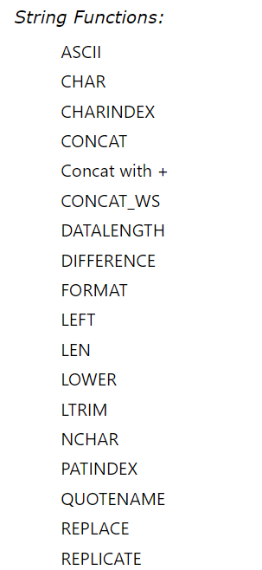
String Functions

Slide 66
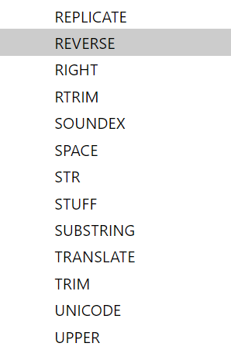
String Functions

Slide 67
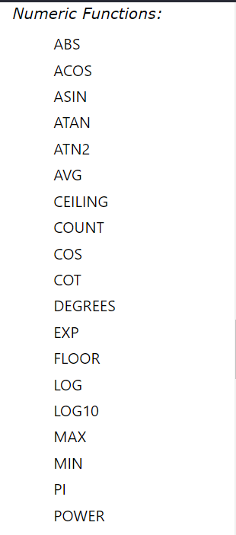
Numeric Functions

Slide 68
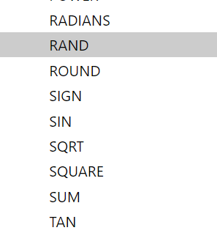
Numeric Functions

Slide 69
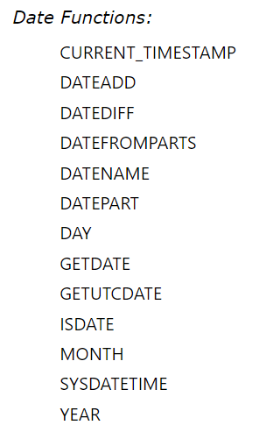
Date Functions

Slide 70
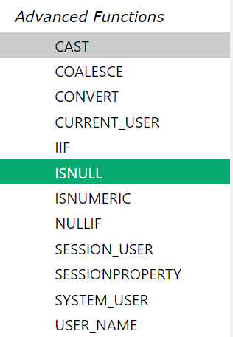
Advance Functions

